Slide 1
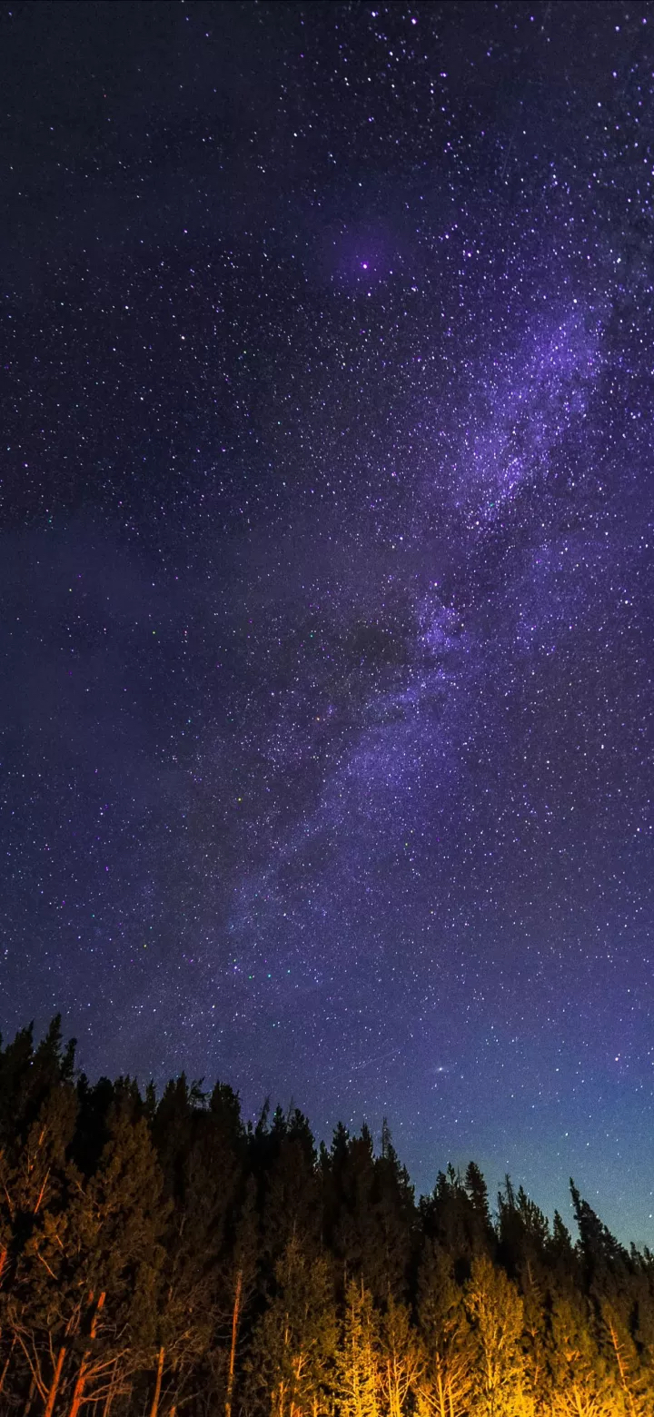
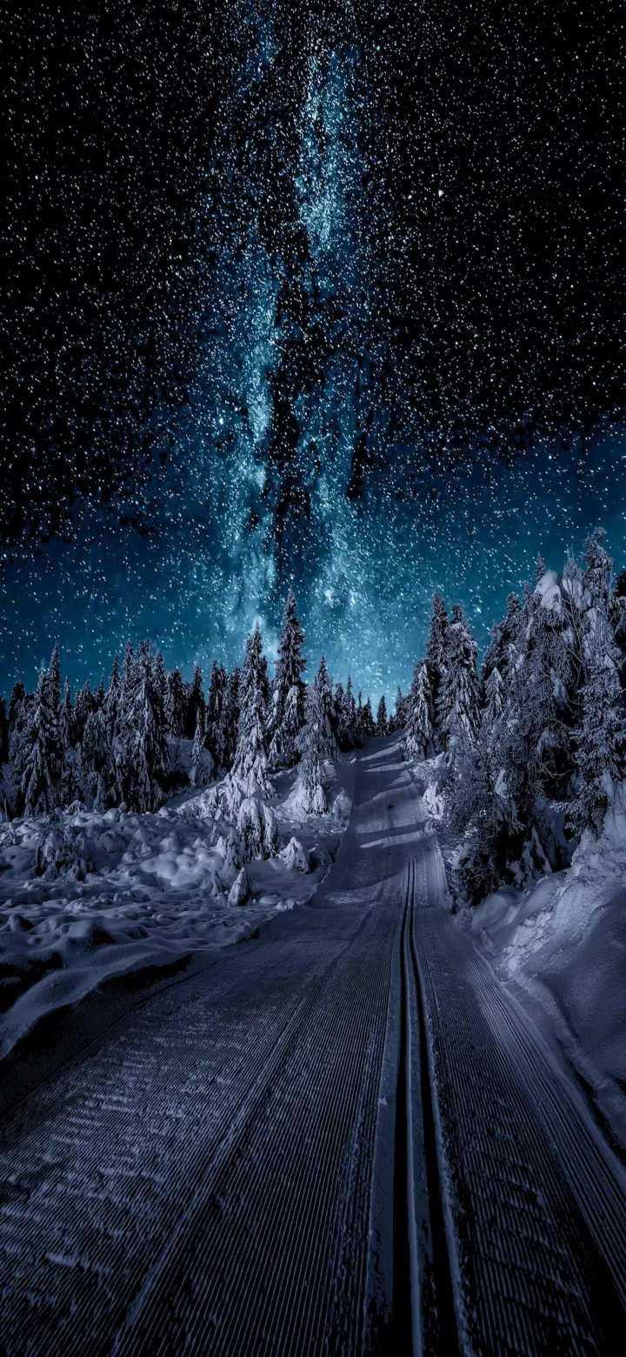
Project 1 First Deliverable The Pitch
Jiajun Yu (Jason)
2021 S1

Slide 2
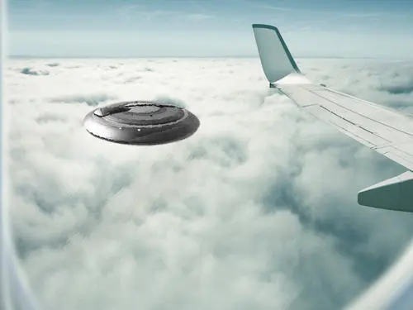
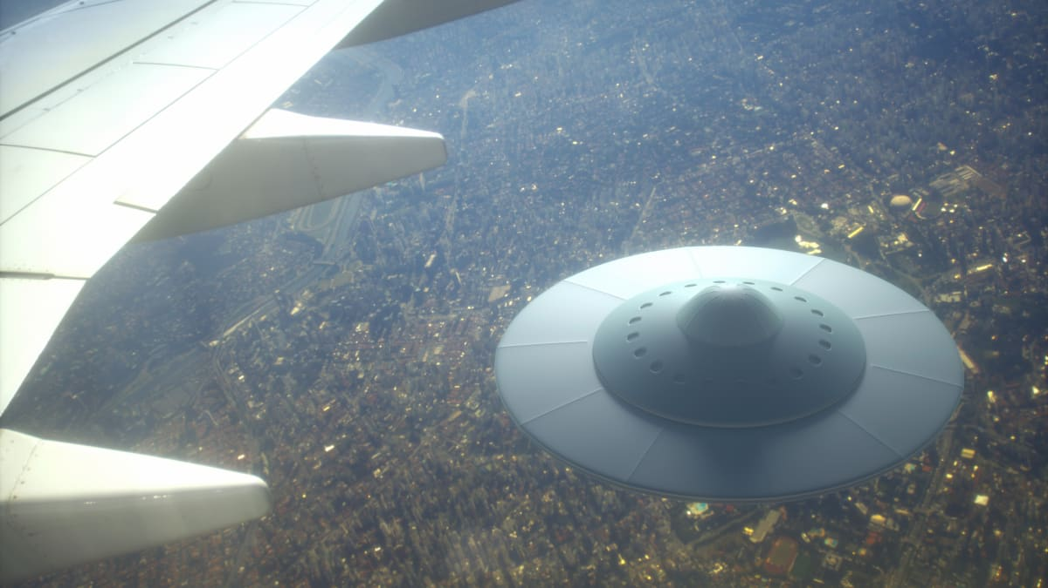
General Topic:
What are the prevailing attributes of UFO ?
---Analysis of UFO based on descriptions of eyewitnesses
(Google)
Purpose:
To analyse and identify the general pattern of the time, durations, positions, shapes ….. of the emergence of UFO
(Google)

Slide 3
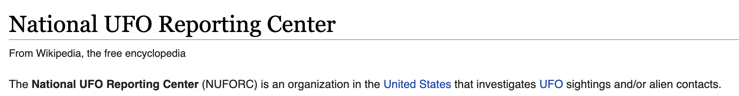


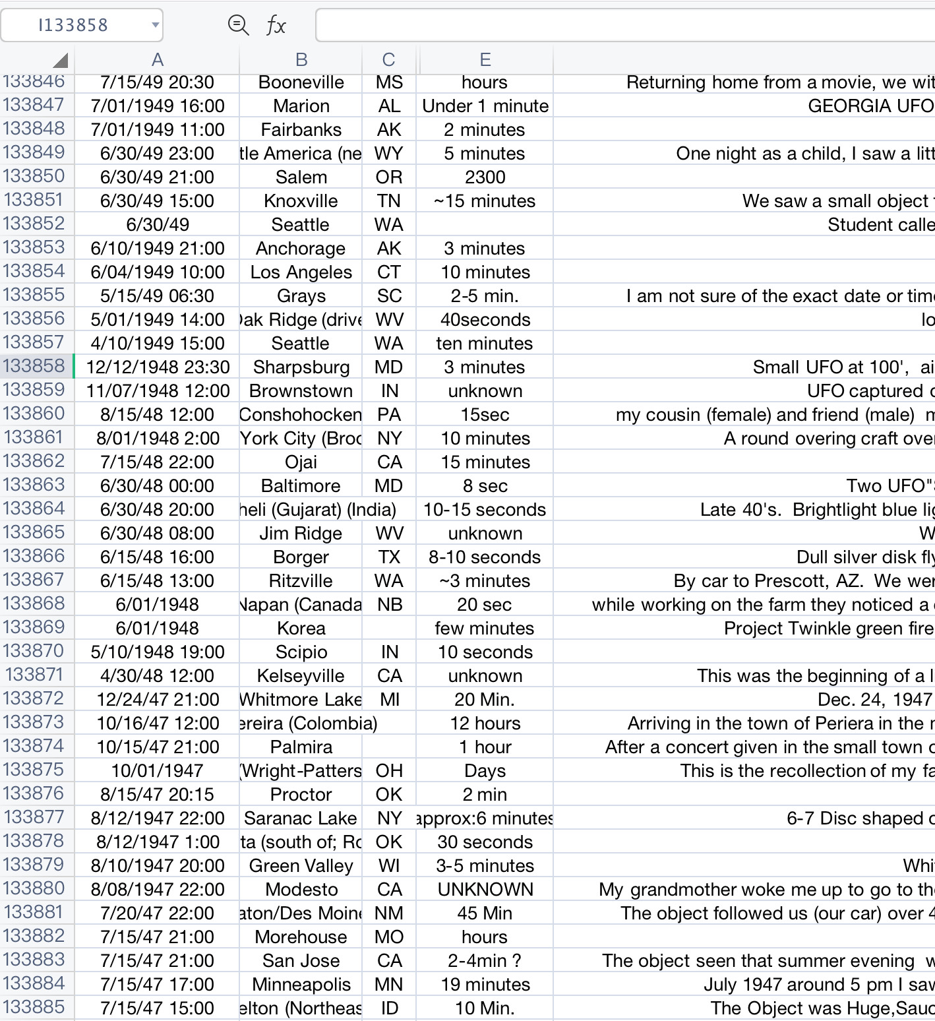
Dataset
(Wikipedia)
1: Credible --- Data from National UFO Reporting Center
2: Data source is relatively new. --- updated at 2021.7.18
3: Dateset is big enough. --- more than 134k records of descriptions
4: Dateset is specific. --- UFO events witnessed in the USA
Challenges / Drawback: Dataset is incomplete for some Excel entries

Slide 4
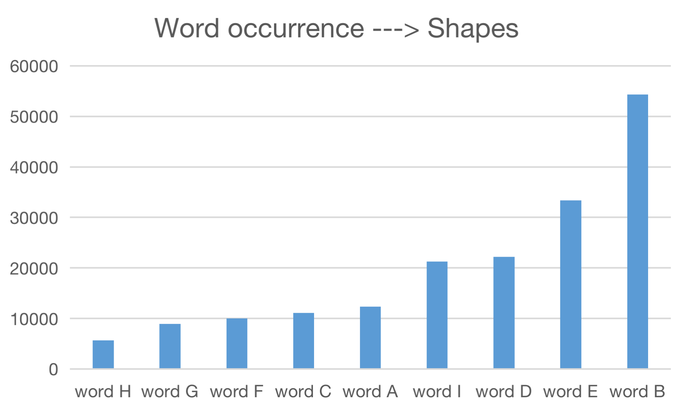
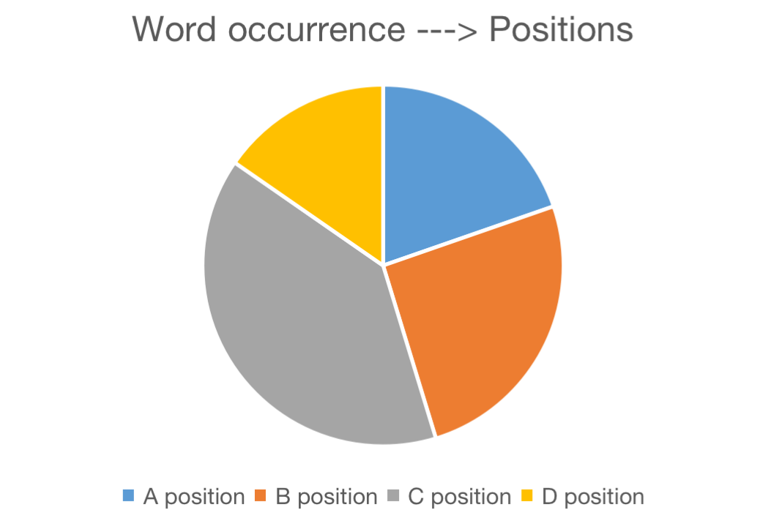
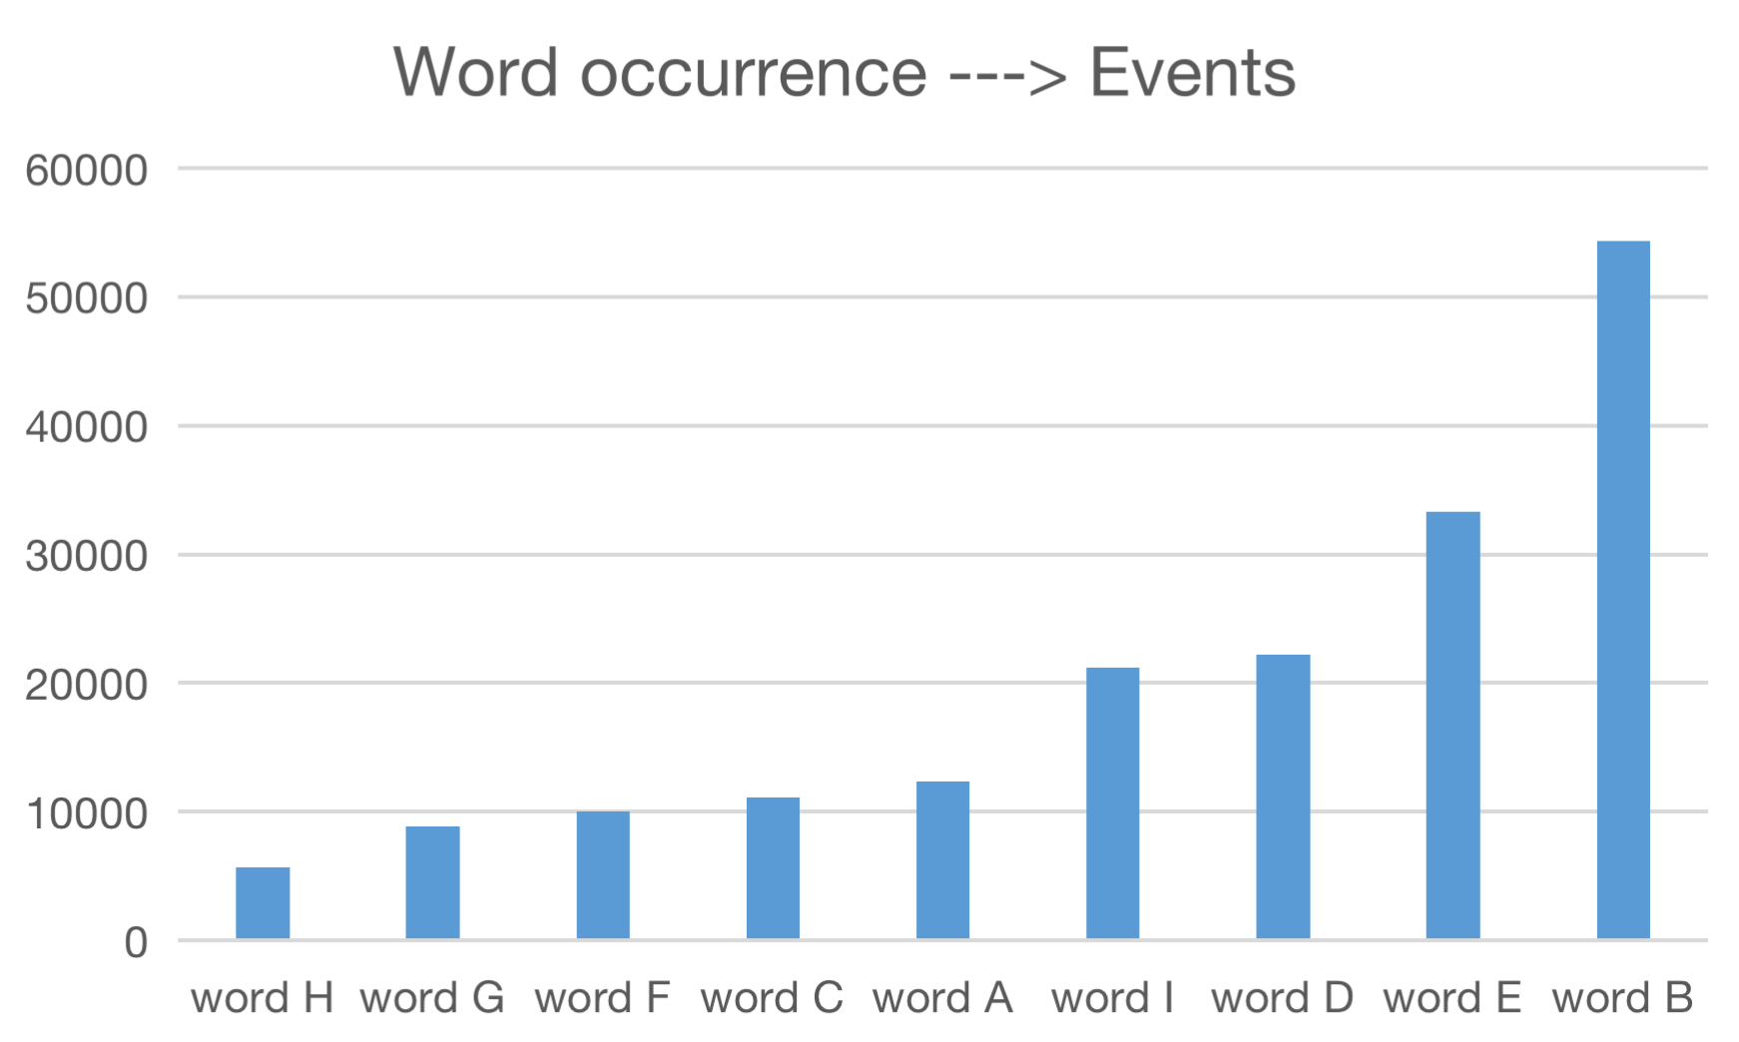
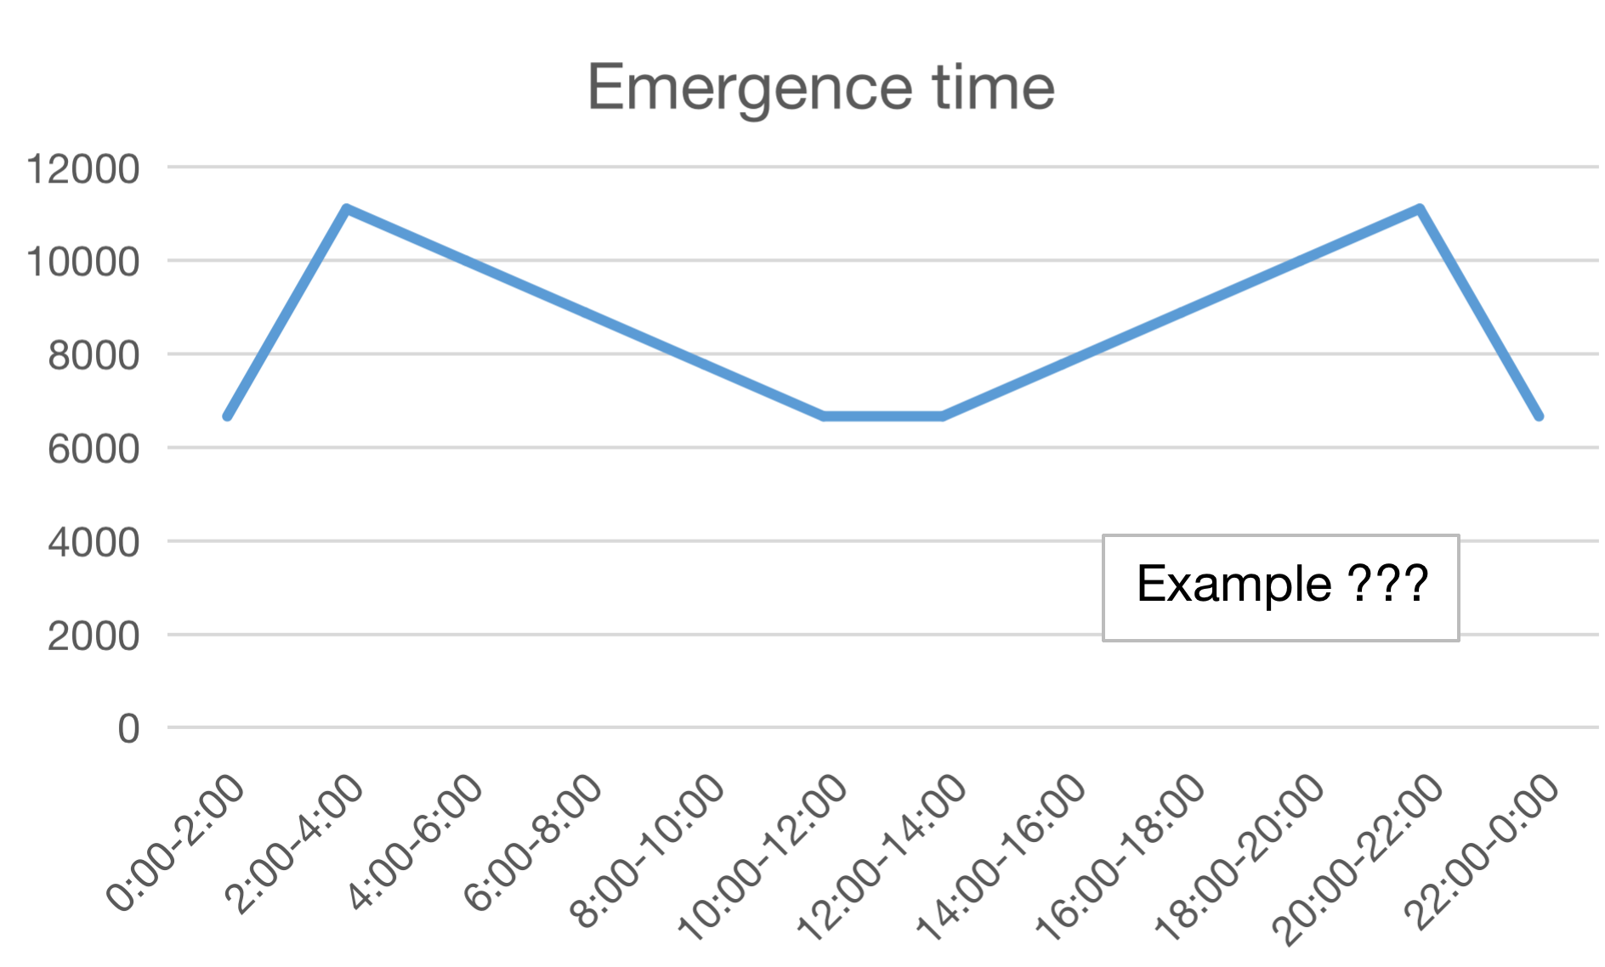
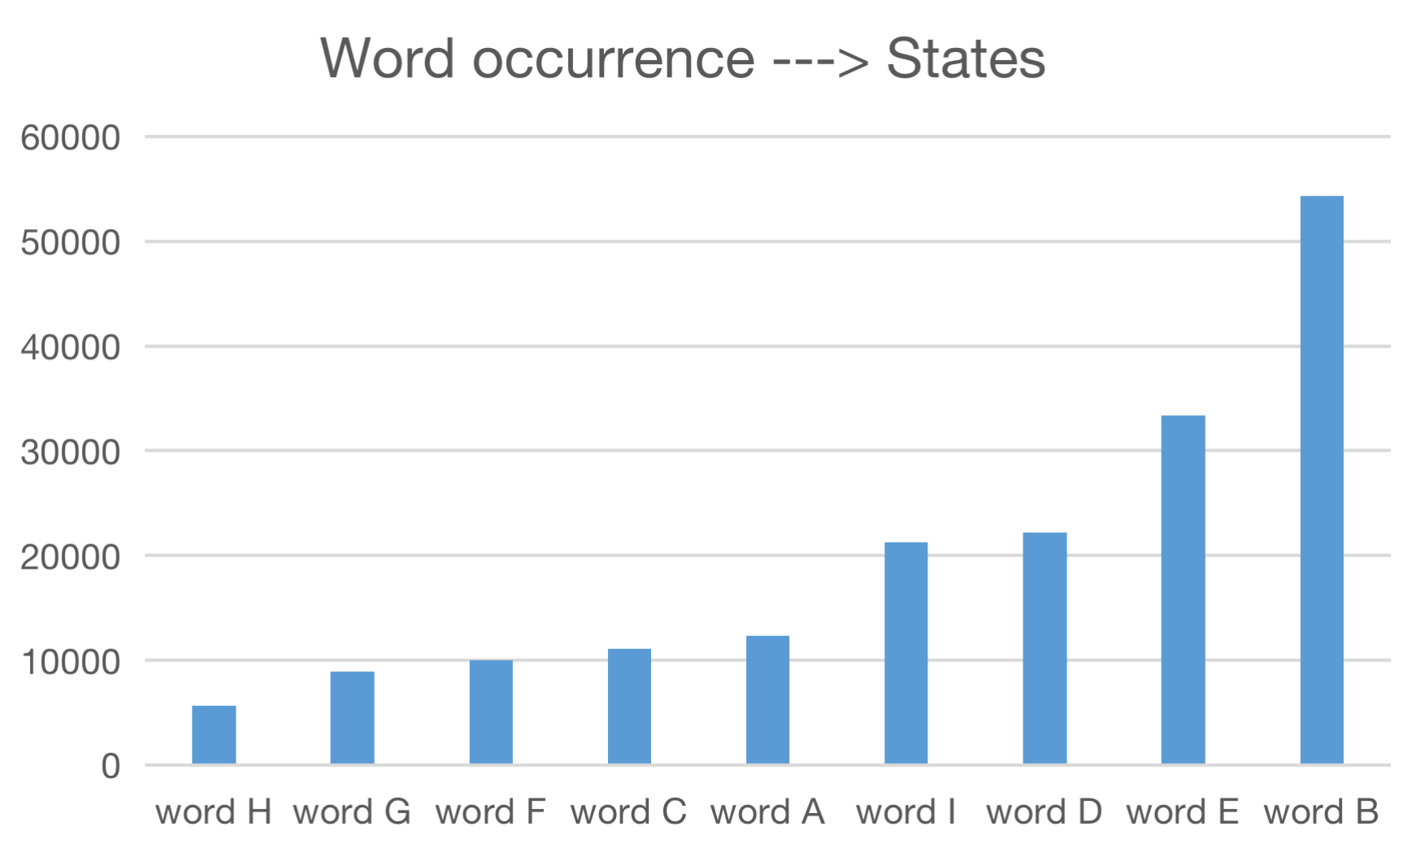
Graphs:
1: Count word frequencies from descriptions ← python and Excel
2: Classfy English words → attributes
3: Visualise ---> barplots / line charts / pie charts / histograms
Methodology:

Slide 5
Timeline:
Week 3 (Pitch)
Summarise feedback / Decide the tools & methods for analysis / Initial visualisations (simple)
Week 4 (First-cut Presentation)
Read some supplemental materials → come up with some more challenging questions
Week 5 (Progect Goal)
Reflections → Improve and modify / Visualisations (the rest of data)
Week 6 (Feedback Presentation)
Prepare for the final presentation / work on my final written report
Week 7 (Final Presentation)
Have a break / do some revisions for other courses

Slide 6
Rough prototype layout of the final presentation
1: my topic
2: the reason of choosing this topic
3: challenges / problems
4: methodology
5---9: visualisations (frequent used words describing shapes / time / durations / positions / events …..)
10: conclusions
11: what I have learned & inspirations

Slide 7
References:
https://www.google.com/imgres?imgurl=https%3A%2F%2Fwww.history.com%2F.image%2Far_16%3A9%252Cc_fill%252Ccs_srgb%252Cfl_progressive%252Cq_auto%3Agood%252Cw_1200%2FMTY0MTk2MzMzNzA2NjE4NzA1%2Fufo-traits-promo-666735176.jpg&imgrefurl=https%3A%2F%2Fwww.history.com%2Fnews%2Fufo-sightings-speed-appearance-movement&tbnid=ygSsQ29hI3srXM&vet=12ahUKEwitwciS-Z3yAhVB7JQKHRMTANoQMygWegUIARCpAQ..i&docid=mdzreP1jt7I5dM&w=1200&h=675&q=UFO&ved=2ahUKEwitwciS-Z3yAhVB7JQKHRMTANoQMygWegUIARCpAQ
https://www.google.com/imgres?imgurl=https%3A%2F%2Fmedia-cldnry.s-nbcnews.com%2Fimage%2Fupload%2Fnewscms%2F2018_01%2F2280531%2F180103-ufo-illustration-mn-1015.jpg&imgrefurl=https%3A%2F%2Fwww.nbcnews.com%2Fmach%2Fscience%2Fufo-hunters-got-one-thing-right-here-s-what-they-ncna834306&tbnid=A7oPqdVPOv_ioM&vet=12ahUKEwitwciS-Z3yAhVB7JQKHRMTANoQMygGegUIARCHAQ..i&docid=dE8DfyNBNqVj1M&w=2500&h=1667&q=UFO&ved=2ahUKEwitwciS-Z3yAhVB7JQKHRMTANoQMygGegUIARCHAQ
https://en.wikipedia.org/wiki/National_UFO_Reporting_Center

Slide 8
Thanks for your listening!

